Slide 1
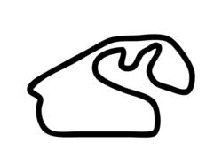
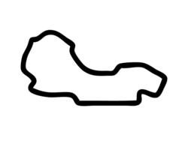
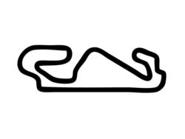
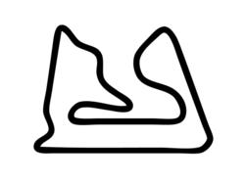
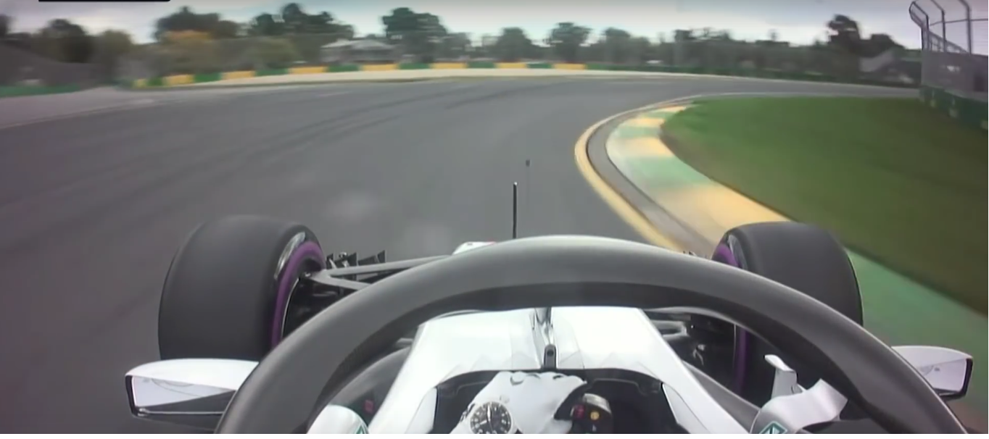
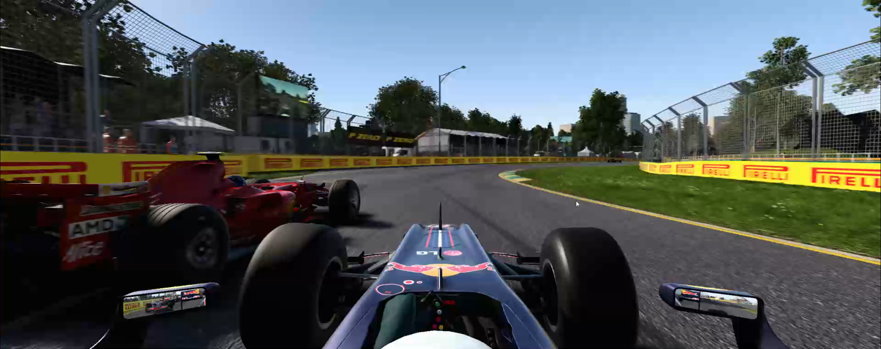

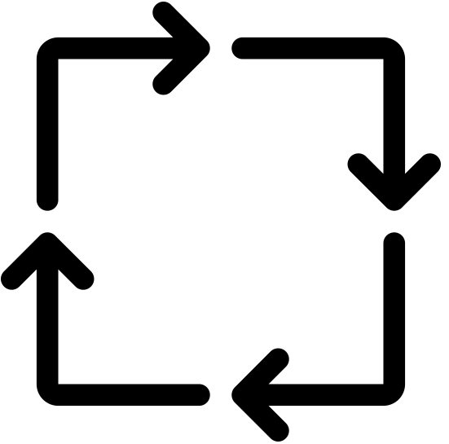


Control Inputs:
Steering
Velocity
Acceleration
Large variety of tracks and car configurations
Utilize Photo-realism of F1 2017™
≈
Virtual Joystick
Real Formula One
Game responds to input
F1 2017™
UDP
C++ API
Closing The Loop
Predicted Steering
AdmiralNet
Annotated Training Images
Assign labels
Game Screenshots
Steering
Velocity
Acceleration

Slide 2





Steering angles from UDP Packets
Steering Angle
Image
Time

Slide 3
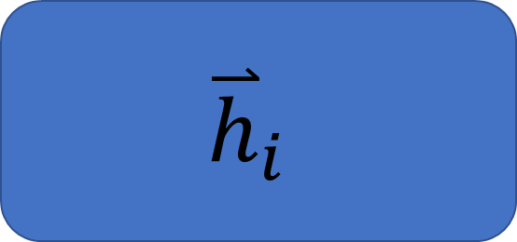

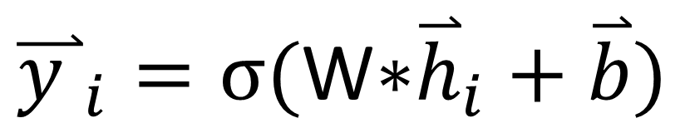


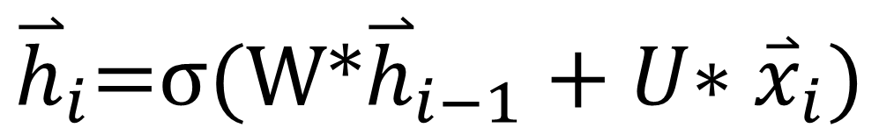

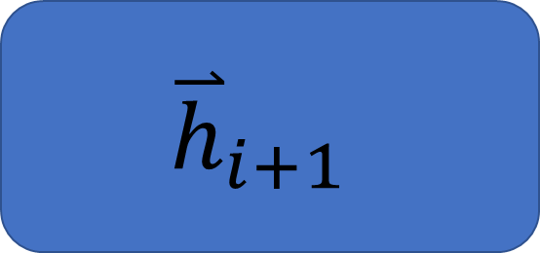
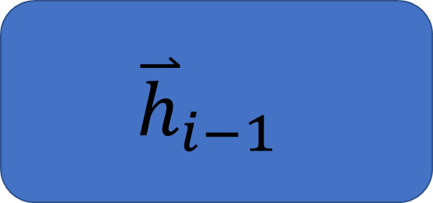



$${\overset{⃑}{y }}_{i}=σ\text{(}\text{W}\text{∗}{\overset{⃑}{h}}_{i}+\overset{⃑}{b})$$
${\overset{⃑}{y }}_{i−1}$
${\overset{⃑}{y }}_{i}$
${\overset{⃑}{y }}_{i+1}$
$${\overset{⃑}{h}}_{i}\text{=}σ\text{(}\text{W}\text{∗}{\overset{⃑}{h}}_{i−1}+U\text{∗} {\overset{⃑}{x}}_{i})$$
RNN Cell
…
Unfold
$${\overset{⃑}{h}}_{i−1}$$
$${\overset{⃑}{h}}_{i}$$
$${\overset{⃑}{h}}_{i+1}$$
$${\overset{⃑}{x}}_{i}$$
${\overset{⃑}{x}}_{i−1}$
${\overset{⃑}{x}}_{i}$
${\overset{⃑}{x}}_{i+1}$

Slide 4
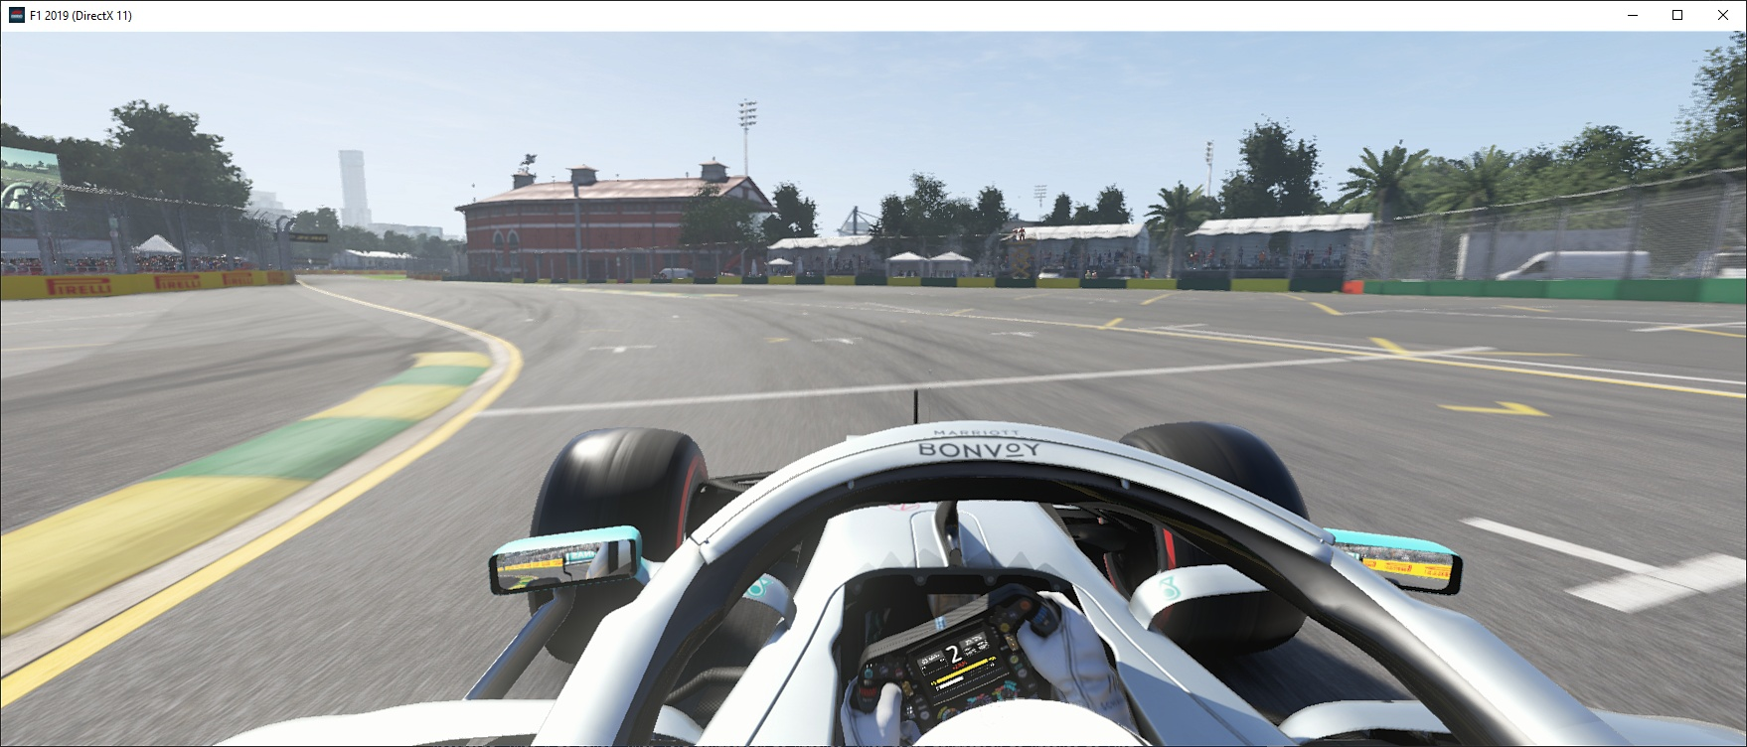
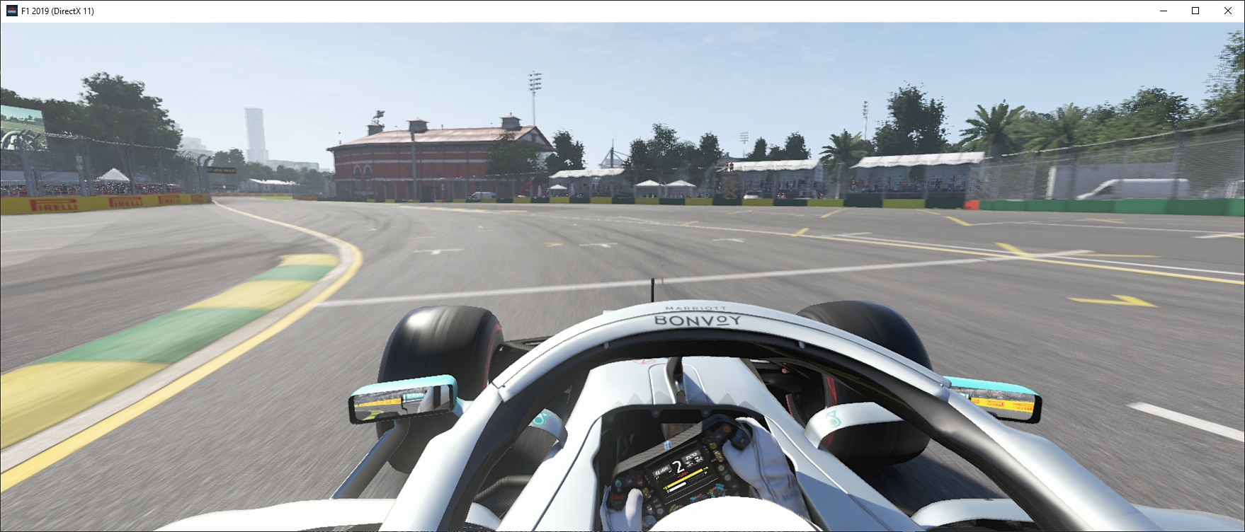
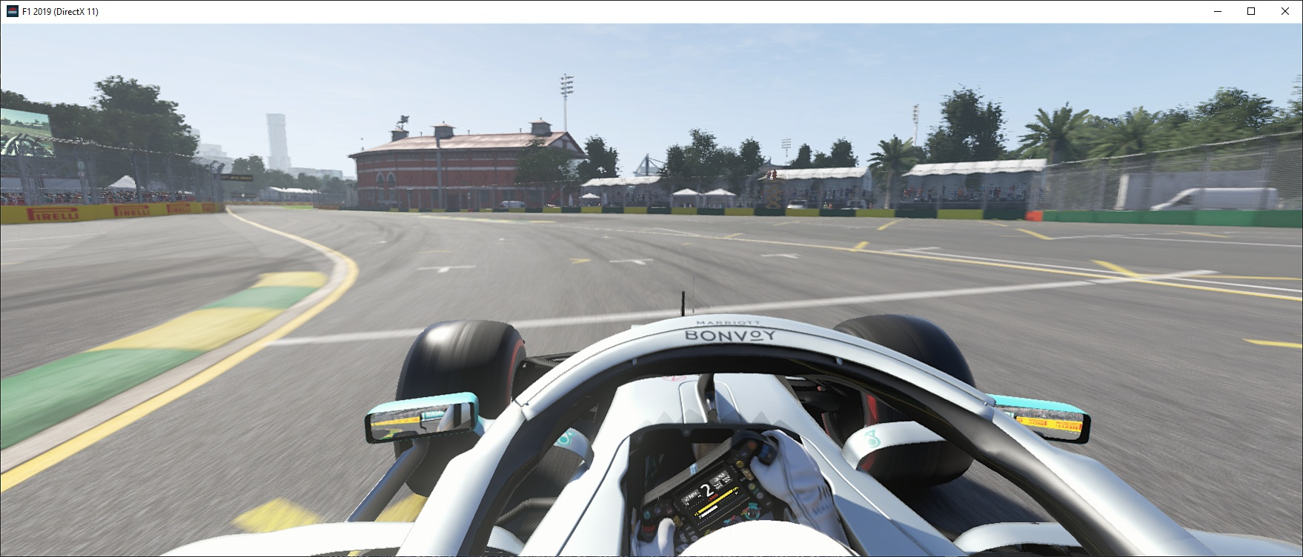
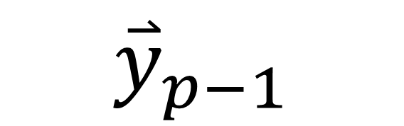





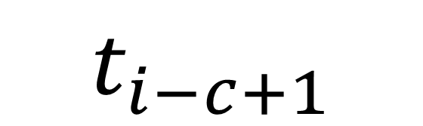
Predicted Waypoints
Build Temporal Context
$${\overset{⃑}{y}}_{0}$$
$${\overset{⃑}{y}}_{1}$$
$${\overset{⃑}{y}}_{p−1}$$
LSTM
LSTM
LSTM
LSTM
LSTM
LSTM
$${\overset{⃑}{h}}_{0}$$
…
…
Deep Convolutional Neural Network
Deep Convolutional Neural Network
Deep Convolutional Neural Network
3D Convolutional Neural Network
Concatenate along time axis
…
$$t_{i−c}$$
$$t_{i−c+1}$$
$$t_{i}$$
Image Sequence

Slide 5

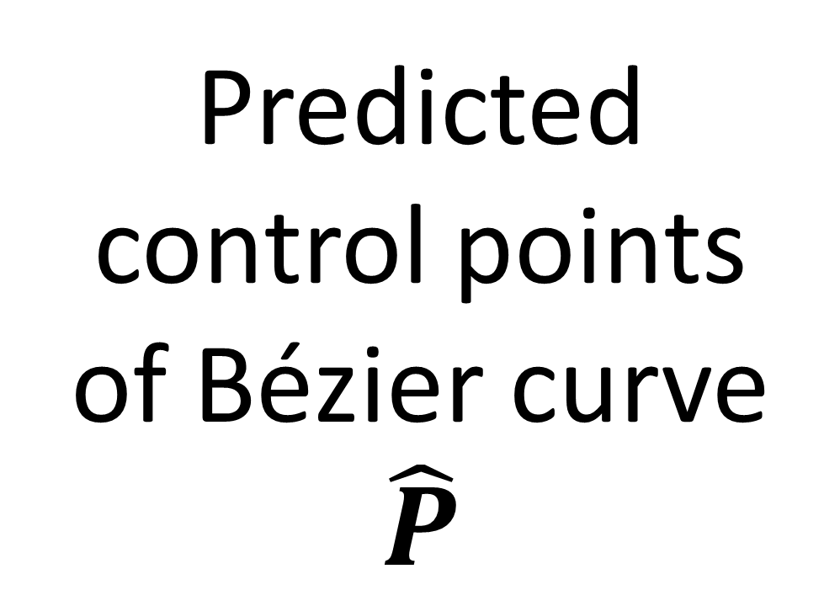


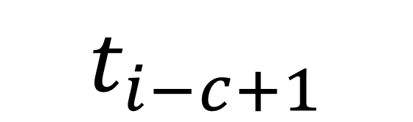
Convolutional Neural Network
Fully connected layers
Predicted control points of Bézier curve
$$\hat{P}$$
Stack along time axis
Build Temporal Context
$${\overset{⃑}{y}}_{0}$$
$${\overset{⃑}{y}}_{1}$$
$${\overset{⃑}{y}}_{p−1}$$
LSTM
LSTM
LSTM
LSTM
LSTM
LSTM
$${\overset{⃑}{h}}_{0}$$
…
…
Convolutional Neural Network
Convolutional Neural Network
Convolutional Neural Network
3D Convolutional Neural Network
Concatenate along time axis
…
$$t_{i−c}$$
$$t_{i−c+1}$$
$$t_{i}$$
Image Sequence

Slide 6
